Slide 1
CAPTAINS TRAINING
Leagues, Knockouts and Events

Slide 2
DOMINIC KING
STUDENT ACTIVITIES MANAGER (SPORT)
HANNAH MORTIER
SPORTS COORDINATOR
BLISS THORPE | GEORGE HINCHLIFFE | NIAMH KELLETT
SPORTS ASSISTANTS
NICHOLA DYER
RECEPTION, ADMIN AND VEHICLES MANAGER
CONTACT DETAILS
bucs@essex.ac.uk
01206 863211 (SU RECEPTION)
07935134538 (BLADES PHONE AN BUCS number on Wednesdays)

Slide 3
AGENDA
Intro to bucs – sports |how to get involved | eligibility requirements | bucs points and league tables
Being excused from lectures
Bucs administrator role
Bucs play
Captains – responsibilities, packs, squad management
Team sheets
Entering results & stats
Social media
Captain match day checklist
Rearrangements/issues
Playing under protest/appeals
Expenses
Match officials & Transportation
Walkovers
Events administration
Summary & support

Slide 4
BUCS SPORTS

Slide 5
how TO COMPETE IN BUCS
Purchase your club playing membership (essexstudent.com/sport).
Become a member of Essex Blades – free with your club membership. It’s important to be a member of the Blades in order to be covered by insurance.
Create a BUCS Play account/profile and join your relevant sport/team.
Add your captaincy and select your team
Note: Some sports may also require individual membership to their governing body e.g. American Football, Basketball, Fencing. for individuals to play. You must have purchased your playing memberships before we will fund any NGB playing fees. DO NOT leave it until the day to sort this out.

Slide 6
PLAYER ELIGIBILITY
WHO CAN PLAY? (Regulation 4)
Must be 18 or over
Must be a student registered at the University of Essex, studying at least 60 credits.
Post grads (Masters) must be studying no less than 50% of full time education.
Term abroad/year abroad students are eligible to play
Placement year students can still compete (as long as placements aren’t longer than 12 months).
SABB officers are eligible to compete.
Colchester institute students are NOT eligible (without an @essex.ac.uk e-mail they are not accepted on BUCS Play to play).
UEIC and foundation students are eligible with an @essex.ac.uk email

Slide 7
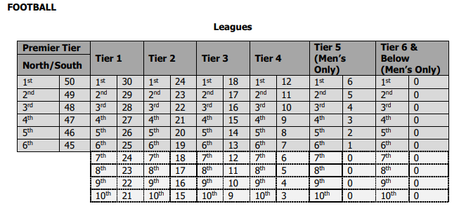
BUCS POINTS
BUCS points differ depending on the league/cup competition your team plays in, in addition to your final league positioning. All points count!
The number of points available per sport/tier can be found on Appendix 1
BUCS WALKOVERS
Giving away 1 x walkover = lose half teams BUCS points.
Giving away 2 x walkover = lose ALL teams BUCS points.
We must do everything possible to avoid any walkovers!

Slide 8
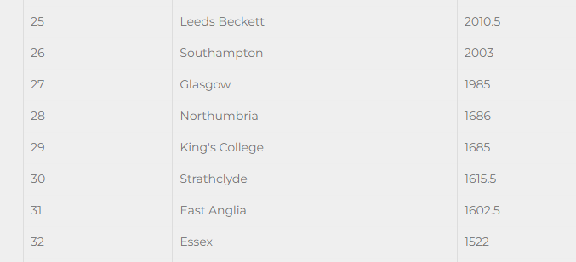
BUCS LEAGUE TABLE
Overall BUCS points are an accumulation of points awarded for league positions, cup competitions and individual/team entries.
Last season (22/23) we achieved 1522 BUCS points finishing 32nd in the BUCS league table, our highest points ever BUT UEA have got in front of us!

Slide 9
being excused from lectures
Whilst the university should have no scheduled lectures on a Wednesday afternoon, we know that players needs to skip Wednesday morning lectures/classes in order to travel to away matches. We have an agreement with the Academic Registrar & Vice Chancellor for students to be excused from Wednesday lectures when competing for the University.
How to get excused from lectures/classes:
Through the ‘My Essex Portal’ you can notify an absence for sport. We’ll then approve it, but only if you are listed on the team sheet.
Please state the sport and team you are playing for to help authorise the request quicker.
YOU WILL NOT BE PENALISED PROVIDING YOU COMPLETE THE FORM

Slide 10
BUCS ADMINISTRATOR ROLE (aka BUCS IA)
First point of contact for ALL BUCS enquiries (bucs@essex.ac.uk)
Management of BUCS teams and captains
Admin rights on BUCS Play
Ensure results have been uploaded (authorised) to BUCS website ASAP
Competition/Team/Individual entries for BUCS
Fixture facility bookings/amendments/cancellations
Transport bookings (Trains, Minibuses & Coaches)
Organises YESREF bookings
First aid arrangement
Co-ordinates fixtures with opposition
Send out fixture confirmations

Slide 11
WHAT IS BUCS PLAY?

Slide 12
LEVELS OF ACCESS WITHIN BUCSPLAY
There are four main role types:
Admins sit at the top of the access chain (BUCS Staff).
Institution Administrators – have control over institution.
Captains/Coaches/Managers – have administrative control over a team (or multiple teams).
Members are all other BUCS Play users without any administrative access (e.g. participants and supporters).
For more information on what tasks each role can complete, click here

Slide 13
CAPTAINS RESPONSIBILITIES
A Captain is defined as an Individual who is responsible for the management of their team and for the selection of their players for fixtures. As well as a student, this could be a coach or manager.
Main point of contact with Essex BUCS administrators
Make sure all players are signed up to BUCS Play before the 1st match.
Ensure officials are booked for each match (check with us on YesRef appointments)
Arrange payment with officials (invoice) - only if not through YesRef
Liaise with the office on transport
Make sure we have a full team for each fixture (help the coach with team selections)
Update the team sheet prior to each match
Approving or disputing opposition team sheets
Enter the scores after the match
Make sure all rules and regulations are adhered to.
Alert BUCS Administrators (bucs@essex.ac.uk) if there are any problems ASAP
Agree and Sign Captains Agreement Form

Slide 14
Captains Packs
ALL COMPLETED CAPTAINS PACKS MUST BE RETURNED TO SU RECEPTION BY 11AM THE NEXT WORKING DAY (I.E. MONDAY FOR WEEKEND MATCHES AND THURSDAY FOR WEDNESDAY MATCHES.
All Captains will receive a captains Pack
This will include
Specific sport regulations
BUCS Medical Exemption Pro Forma
BUCS Playing Under Protest Form
BUCS Team Sheet Pro Forma
Serious Accident/Emergency Procedure
Accident/Incident Report Form
Concussion Recognition Tool Guide
Note: If you run out of any forms please ask SU Reception for further copies when you return your completed forms each week.

Slide 15
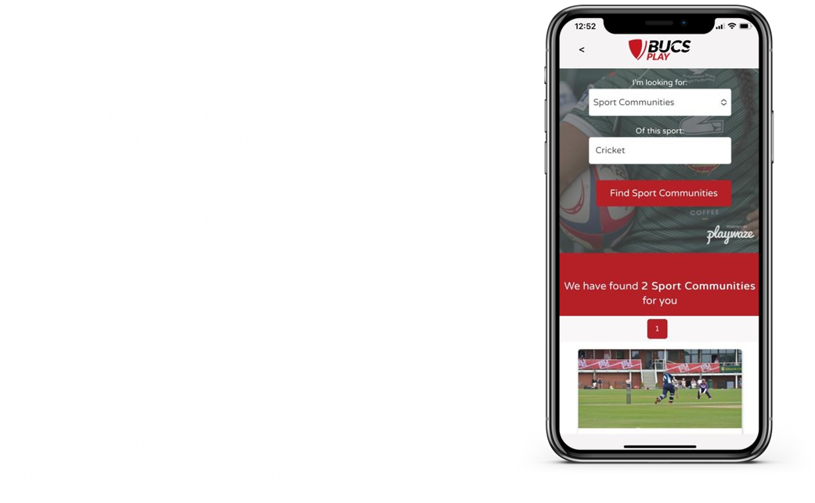
HOW TO BECOME A CAPTAIN ON BUCS PLAY

Slide 16
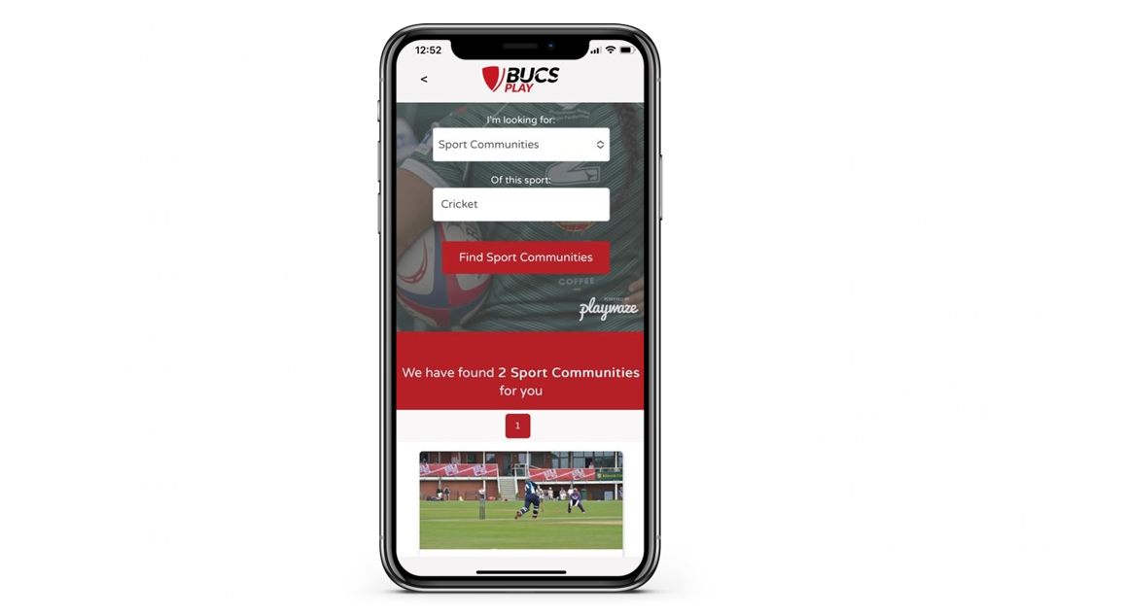
JOIN YOUR SPORT COMMUNITY

Slide 17
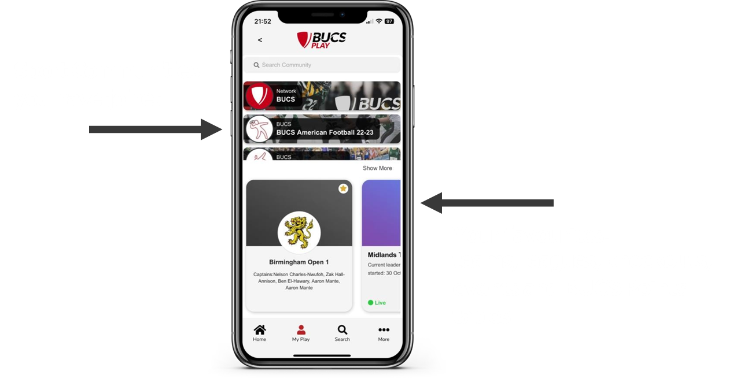
MY PLAY

Slide 18
QUICK TIP

Slide 19
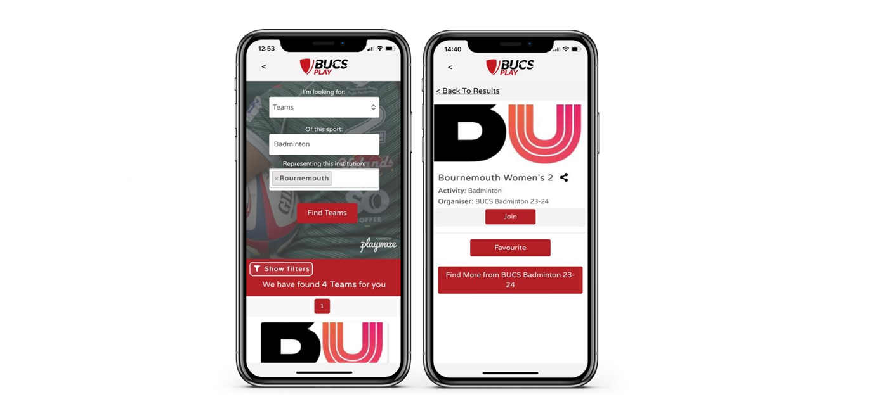
JOINING A TEAM ON APP

Slide 20
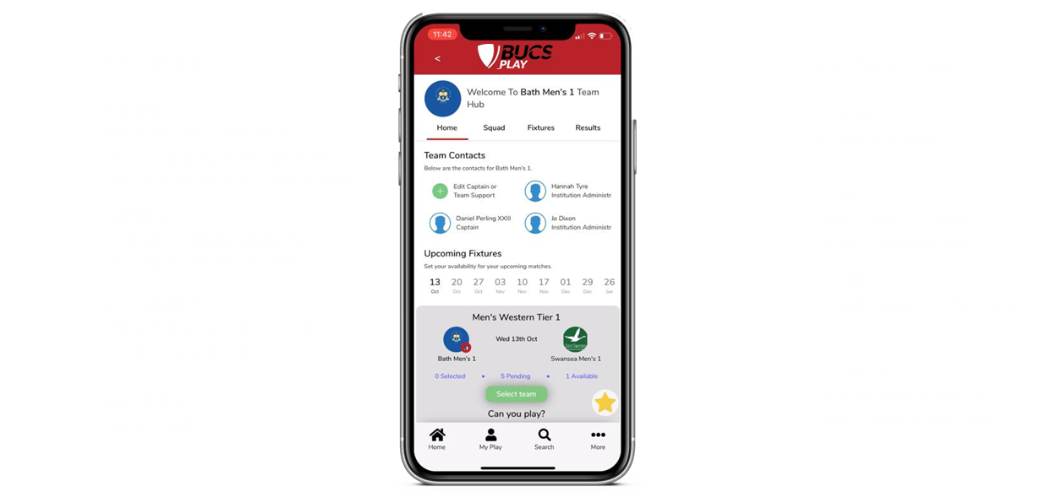
TEAM HUB

Slide 21
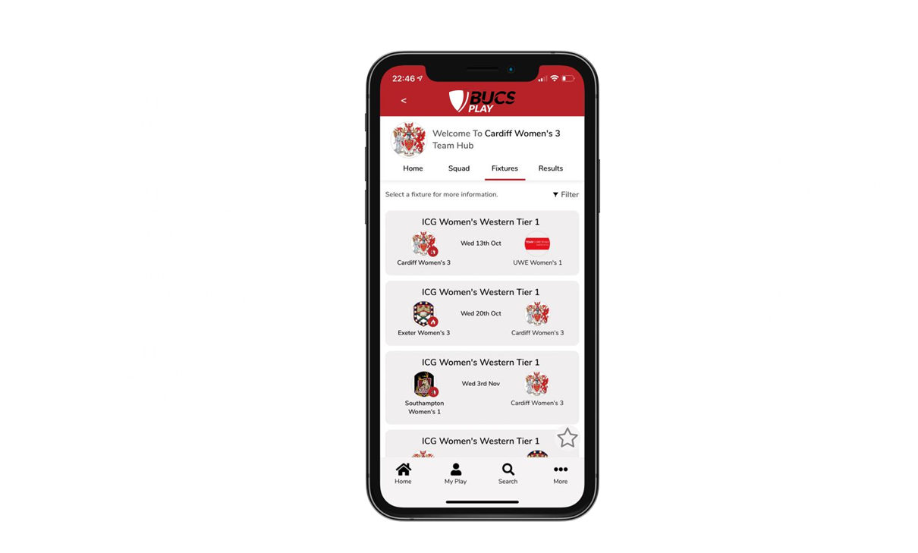
VIEW FIXTURES

Slide 22
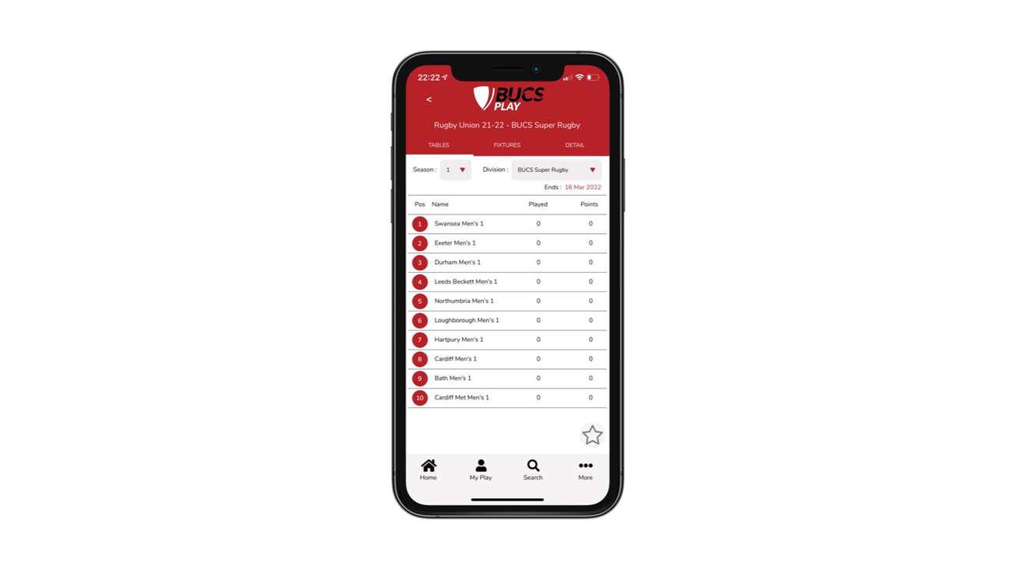
VIEW LEAGUE TABLES

Slide 23
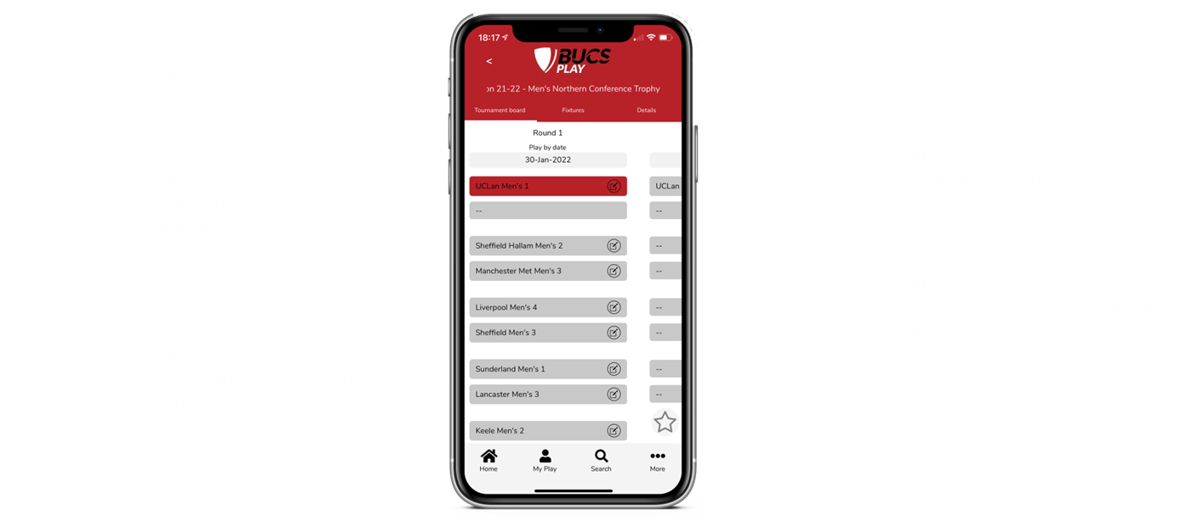
VIEW KNOCKOUTS

Slide 24
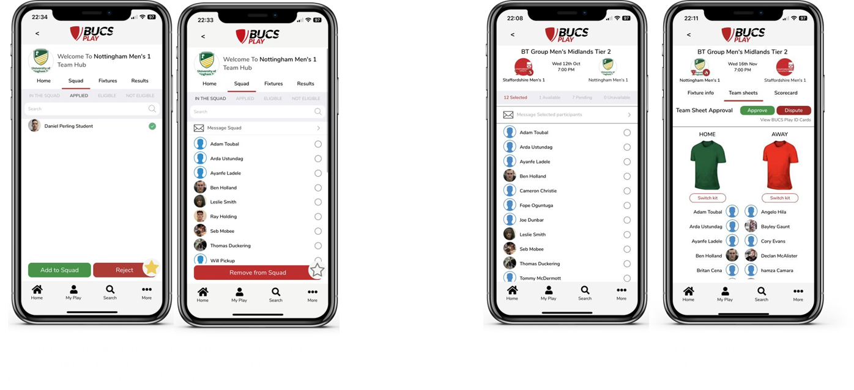
SQUADS VS TEAMSHEETS

Slide 25
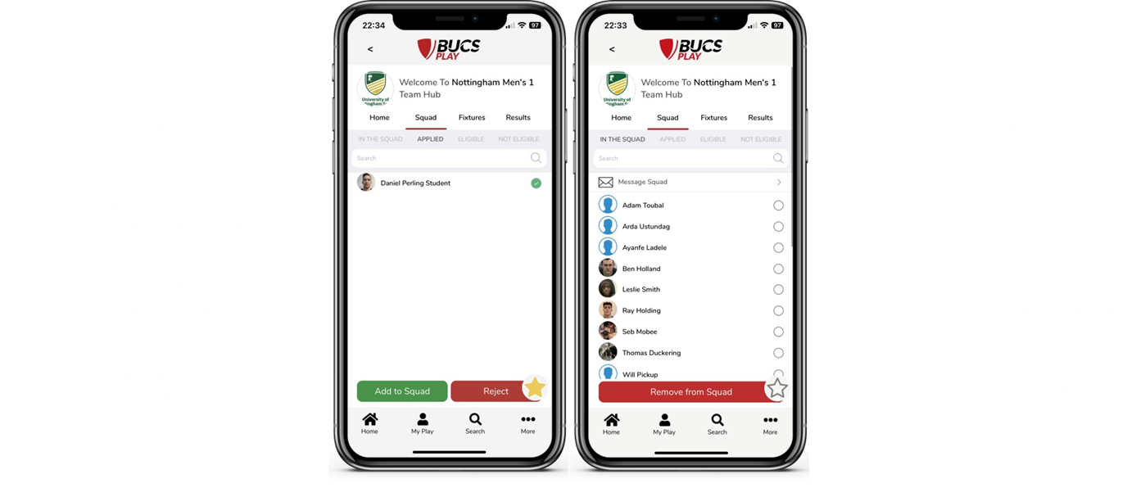
SQUAD MANAGEMENT ON APP

Slide 26
TEAM SHEET SELECTION
BUCS Play will NOT automatically calculate when a player has established a ‘normal’ team and can no longer play down a team.
Once a player has played the majority of the season for a team, they must remain in that team.
It’s OKAY to play up and help a team out when needed. If you have multiple teams you must always prioritise fielding the highest teams i.e. 1st team before fielding the lower ranking teams.

Slide 27
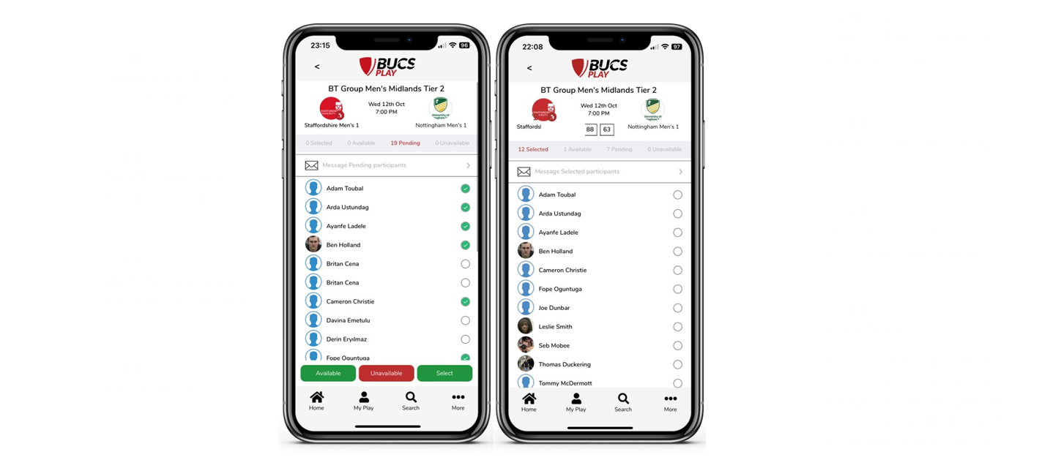
TEAM SHEET SELECTION

Slide 28
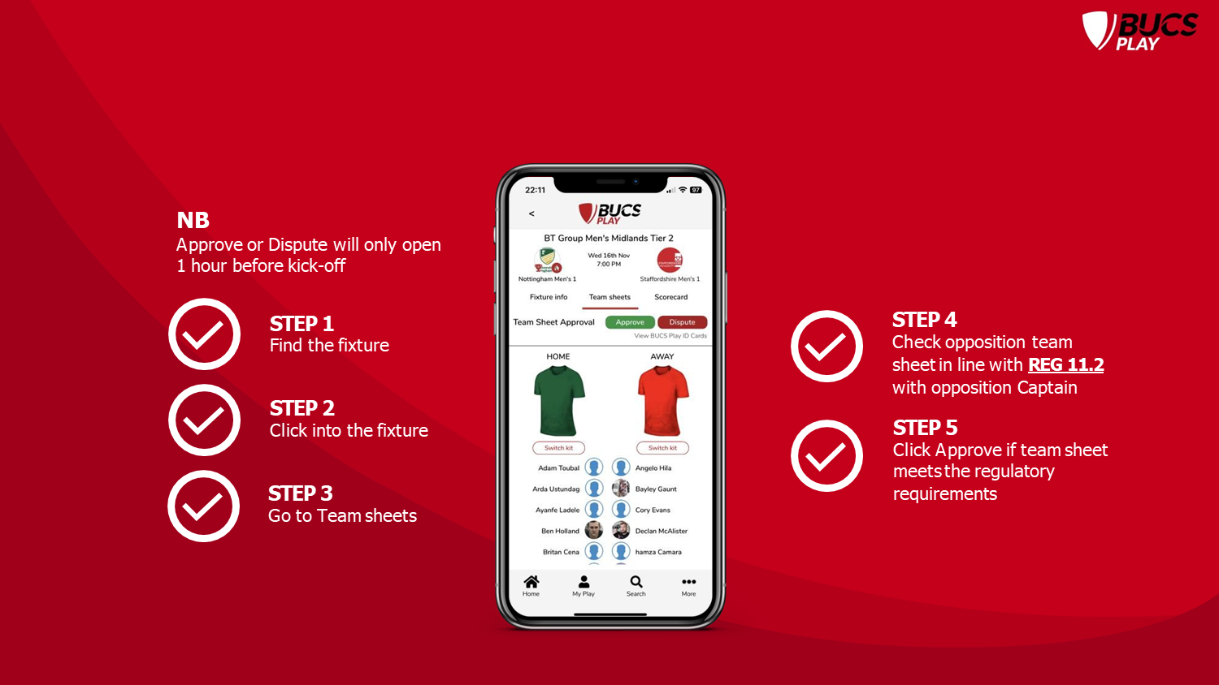
TEAM SHEET APPROVAL ON APP

Slide 29
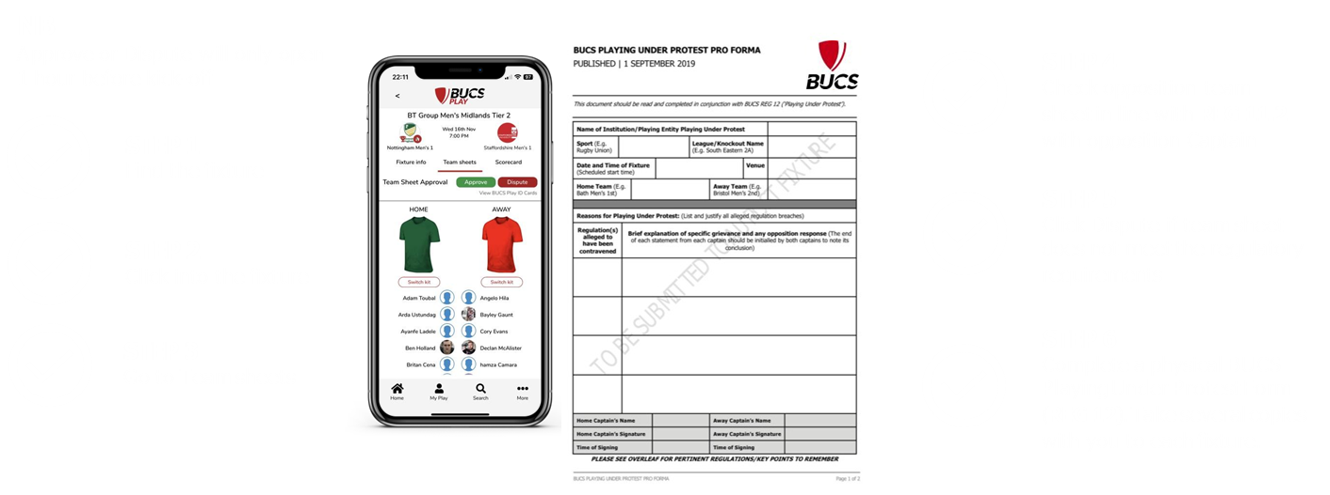
DISPUTING A TEAMSHEET
Note: A paper copy will be in your physical captains packs.

Slide 30
PAPER TEAMSHEETS
Note: A paper copy will be in your physical captains packs.

Slide 31
ENTERING A RESULT
RESULTS MUST BE ENTERED ON BUCSPLAY BY TEAM CAPTAINS IMMEDIATELY AFTER THE COMPETITION.
NB: REG 13.1 - The results of all league and knockout competition matches must be recorded on BUCS Play no later than 12:00 on the first working day following the fixture!
IN ADDITION TO ENTERING ON BUCS PLAY Please ensure you:​
E-MAIL THE RESULT TO BUCS@ESSEX.AC.UK​ AND CONFIRM IF THERE WERE ANY ISSUES WITH THE MATCH I.E. PLAYING UNDER PROTEST FORMS, BEHAVIOUR ISSUES ETC.
RETURN YOUR COMPLETED CAPTAINS PACK FORMS TO SU RECEPTION BY NO LATER THAN 11.30AM THE FOLLOWING WORKING DAY (I.E. MONDAYS FOR WEEKEND MATCHES AND THURSDAYS FOR WEDNESDAY MATCHES)

Slide 32
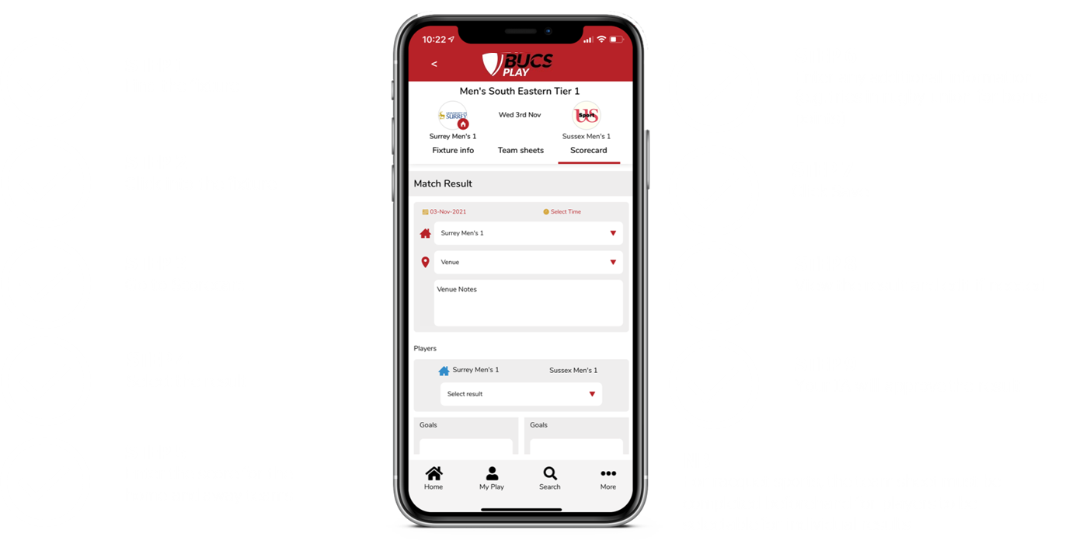
ENTERING A RESULT

Slide 33
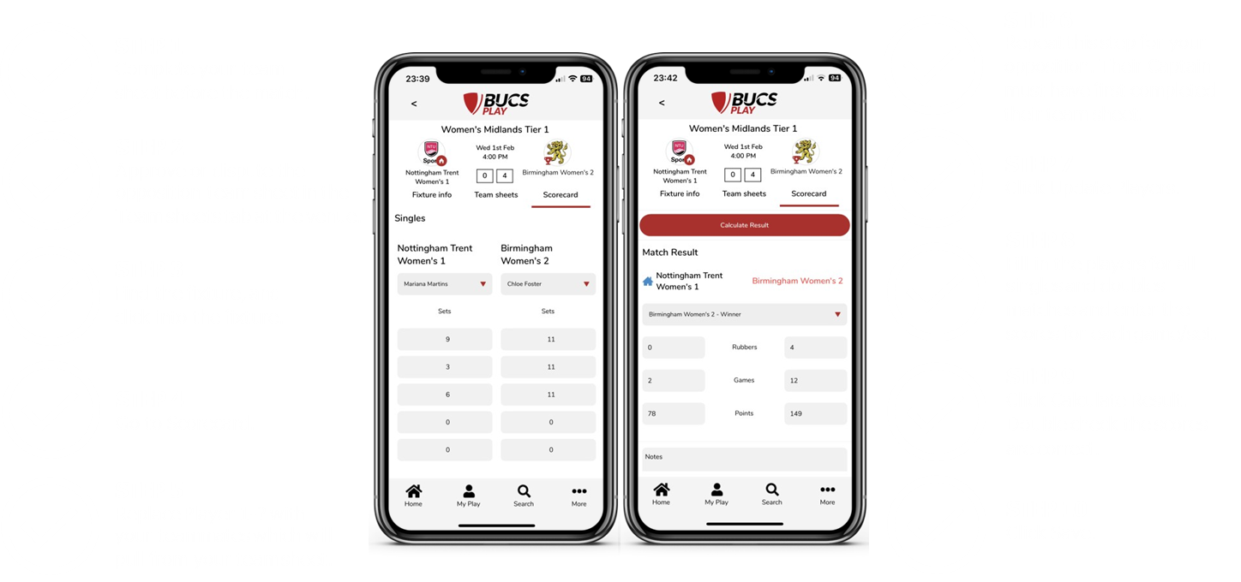
RACQUET SPORTS RESULT ENTRY

Slide 34
SQUASH LEVELS

Slide 35
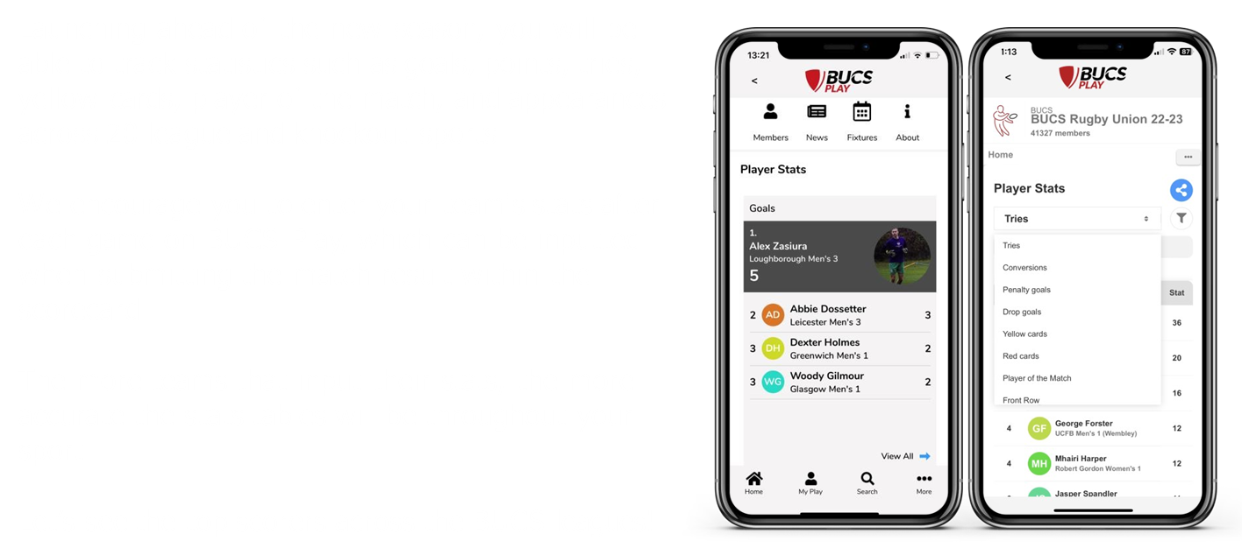
PLAYER STATS

Slide 36
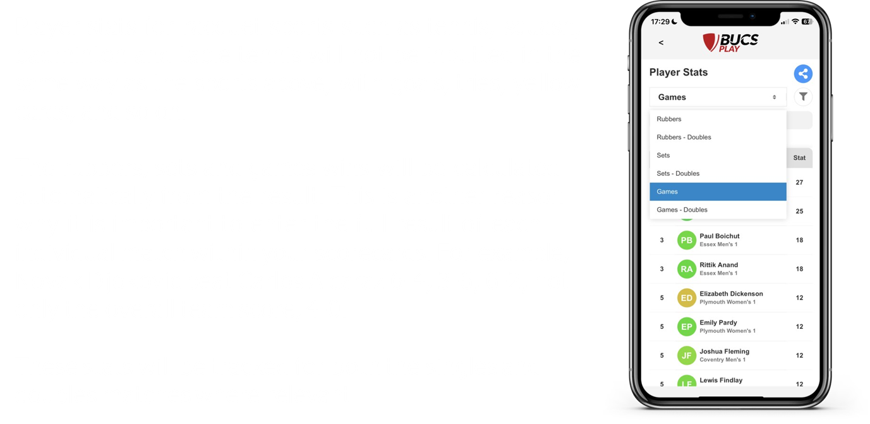
STATS FOR RACQUET SPORTS

Slide 37
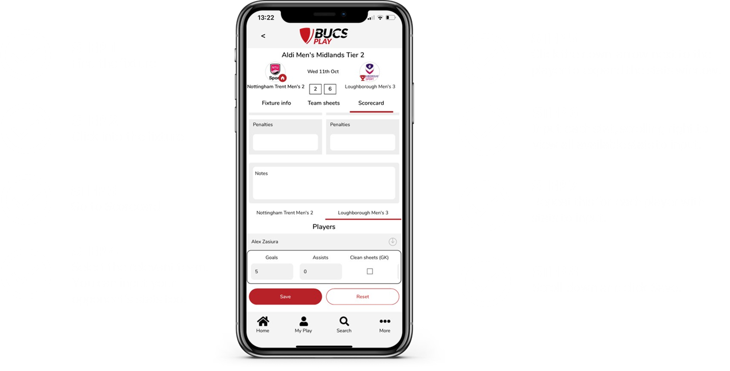
PLAYER STATS ENTRY ON APP

Slide 38
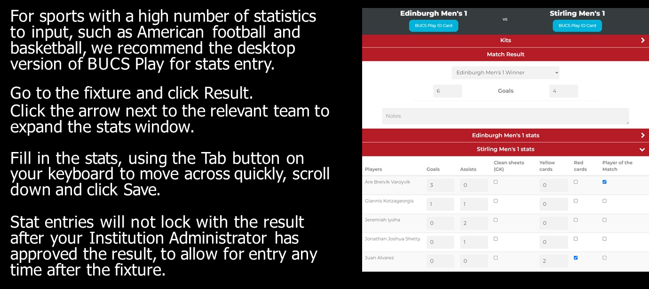
PLAYER STATS ENTRY ON DESKTOP

Slide 39
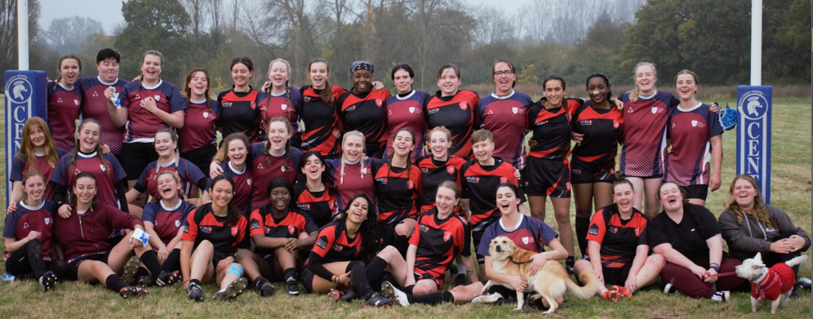
SUBMITTING YOUR RESULTS TO US
DON’T GO TO FED BEFORE SUBMITTING YOUR RESULT!
Home captains: Important to enter results straight away (win or loss).
PLEASE COMPLETE THE TYPEFORM AT : HTTPS://ESSEXSU.TYPEFORM.COM/TO/VUHCAOIL

Slide 40
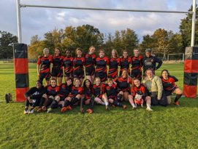
SOCIAL MEDIA
Please tag us in all your match day/training posts on Facebook/Instagram/X #BackTheBlades
Our social media:
Instagram - @EssexbladesSU
Facebook – Essex Blades SU
Twitter/X - @EssexbladesSU

Slide 41
CAPTAIN'S MATCH DAY CHECKLIST
ADD NEW PLAYERS TO YOUR SQUAD ON BUCS PLAY
FILL IN YOUR TEAM SHEET
GO TO YOUR FIXTURE VENUE
APPROVE OR DISPUTE OPPONENTS TEAM SHEET
PLAY FIXTURE
SUBMIT YOUR RESULT
ENTER YOUR PLAYER STATSCELEBRATE AT FED
CELEBRATE YOUR RESULTS AT FED NIGHT
RETURN YOUR PHYSICAL CAPTAINS PACK AND COLLECT NEW FORMS FOR NEXT FIXTURE

Slide 42
WHAT DOES YOUR TEAM NEED TO KNOW?
EVERY athlete who wishes to compete in a BUCS team must create a BUCS Play account and join their team to be eligible to participate.

Slide 43
REARRANGEMENTS/ISSUES
If you foresee a problem fielding a team for a particular fixture, please alert Essex BUCS Administrators ASAP. The more notice you give us, the more chance we can sort something out.
YOU CAN CONTACT US ON THE BLADES PHONE 07935 134538
It’s NOT possible to move fixtures less than 48 hours before.
Any fixture changes must be agreed by both BUCS administrators
Do NOT contact opposition captains to make changes – all changes MUST go through the SU BUCS Administrators. If anyone contacts you to change a fixture please direct them to bucs@essex.ac.uk

Slide 44
Playing under protest
REG 12.11 of BUCS Rules & Regulations states that:
“If a team feels, upon arrival or during a fixture, the conditions do not adhere to those outlined in the BUCS regulations or fixture confirmation they should complete a 'Playing Under Protest’ form or equivalent as soon as the grievance is noted.”
Please note: Only where a regulation has been breached can an appeal be made.

Slide 45
QUESTION
“What information do I need to complete a Playing Under Protest form?”

Slide 46
ANSWER
Fill out all the fixture details
State the specifics rules/regs broken and explain briefly
Each captain must initial next to each reg
Oppositions have the opportunity to write a statement to explain
Both captains must sign and include the time of signature
Neither captain can refuse to sign this form.
REG 12.3.2.1 Refusal to sign may result in a charge of misconduct being raised against the institution/Playing Entity and appropriate disciplinary action taken in accordance with REG

Slide 47
QUESTION
“I know the opposition has breached a regulation, but I do not complete the Playing Under Protest form. Can I appeal after the match?”

Slide 48
ANSWER
NO. The form must be completed as soon as the grievance is noted.
As such, if you arrive at the facility and it is not fit for purpose/in line with BUCS regulations, fill in the form straight away and ensure that it is signed with the opposition.
If you fail to do so, in knowledge of the breach, then you are deemed to have accepted the conditions of play and therefore cannot play under protest nor lodge an appeal.
This includes if you are made aware of the breach prior to travelling to the fixture but decide to play regardless.

Slide 49
Making an appeal
If the opposition have broken rules AND a playing under protest form has been completed correctly we will put in an appeal with BUCS to claim the walkover.
In order to lodge an appeal, captains must return the Playing Under Protest form to Blades/ SU Reception by:
11am on Thursday (Wednesday fixtures)
11am on Monday (Weekend fixtures)
The playing under protest form itself does not allow you to dispute a fixture result, completing this form just gives you the right to submit an appeal. The appeal must include the specific regulation(s) that are being disputed on the form.
The Playing under protest form must be signed by both captains and should be completed as soon as a suspected breach of regulation has been identified. You can request an official to pause the match, if you identify an issue, whilst you complete the form.
The Essex IA will review the appeal and decide whether to submit this officially to BUCS. We have until 5pm the next working day after the match being disputed to submit an official appeal.
Failure to submit to us by these times, means nothing can be done.
Send the BUCS Admin team an email at bucs@essex.ac.uk and call the SU office straight away for advice.

Slide 50
Expenses
Any expense incurred related to your BUCS match can be reclaimed providing this was approved by BUCS Administrators
In order to do this you will need to follow this link - Expense Reclaim Typreform
You can claim an expense for the following purposes:
Underground travel (we don't usually book travelcards as it's cheaper to use a debit/credit card and reclaim)
Bus travel to get from train station to venue
Taxis at end station (receipts are needed)
Accommodation where this is necessary and approved
Officials payments (receipts are needed) where not though YesRef

Slide 51
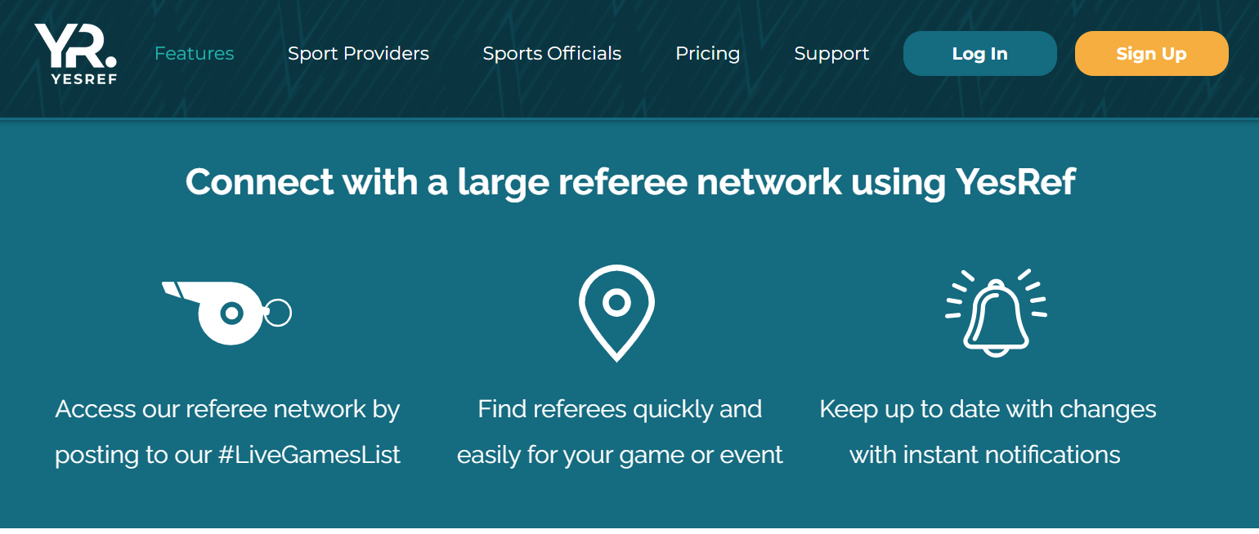
MATCH OFFICIALS
American Football (booked through BAFRA)
Basketball (SU book refs but not table officials)
Fencing
Football
Futsal
Hockey
Lacrosse
Netball
Rugby Union
Volleyball
Water Polo

Slide 52
MATCH OFFICIALS
Captains must book officials, ensuring that the correct level of official is booked (this varies depending on the league you play in).​
Appendix 5 explains the level of qualification required for each sport.​
​
​
Neutral shall be taken to mean not being a current student, a member of staff (full-time or part-time), a member of the team, club* or Athletic Union (or equivalent) of the institution/Playing Entity concerned, or, being closely related to any member of the club. *A member of the club shall be taken to mean any player, coach, elected officer or team official.​
​
You must get written confirmation of bookings! (e-mails/texts). If a ref cancels last minute, we can then provide evidence that they were booked.​
​​

Slide 53
PAYING OFFICIALS
Officials booked through YesRef will be paid through the app after the match
Officials not booked through YesRef will need to submit invoices in order to get paid​
These need to be submitted to suinvoices@essex.ac.uk​ by Thursday morning
Payment runs take place every Wednesday – week after a fixture​
If invoice is submitted before this point, the recipient should receive funds within 5 workings days

Slide 54
TRANSPORT
Transport costs for BUCS are all covered by our central budget, but please pick the cheapest, most suitable method of transport to get your team to the match.​
In order of cost (low to high):​
Cars​
Train/Tube​
Externally hired minibuses and coaches​
​
We will not refund any taxis (unless agreed in advance).​

Slide 55
CARS
If you drive your own personal car to a fixture, you are eligible to claim back between 25p-45p* per mile travelled. You can claim this back through a BUCS expense form (available from SU reception).​
​* an additional 5p/mile for each additional passenger taken
Students who wish to drive will need to send a photo of their driving license (front and back of card) and a copy of their insurance document to blades@essex.ac.uk before being able to claim back any expenses.​
This is usually the cheapest method of transport, so we will encourage teams to drive where possible.​
​

Slide 56
trains
The sports office have a business account with Trainline and therefore works out cheaper for us to book the tickets for teams and prevents players from paying and claiming back costs. ​
A member of the Students’ Union Sports Team will contact team captains, usually on a Thursday to ask whether any train tickets need purchasing for their team (including team support staff where applicable*)​
Captains must reply, confirming how many tickets need purchasing, by the end of the day. ​
You will receive a confirmation e-mail, with reference number, when the tickets are booked, which can then be collected from any ticket machine at any train station using any debit card (you will not be charged anything).​
​
​

Slide 57
Externally hired minibuses/coaches
These will only be booked if there are sufficient people and/or teams going to the same area, in order to make the coach cost effective. This might mean leaving early/waiting for other matches to finish.​
If your team is eligible to travel to an away fixture via coach, team captains will be notified, usually on the Thursday before the following week’s fixture. Your team will generally be selected to travel via coach if two or more larger Essex Blades teams are travelling to the same university or nearby venues. ​
Sports Coordinator is in charge of booking coaches (working in partnership with Roman Coaches for BUCS bookings). They will inform team captains the week before a fixture if they have been allocated a coach. You MUST NOT book your own minibus/coach with an external provider. Please contact bucs@essex.ac.uk for any coach quotes/enquiries.​
​
Coaches will be booked as the last resort and only if costs can be justified.​

Slide 58
Su people carrier
You need to become an SU Registered driver in order to hire our SU MPV.​
To become an SU Registered driver you will need to provide the Reception manager with a DVLA check code and a copy of the front and back of your drivers license, you will also need to have held a full UK driving license for 1 year and be 20yrs or older, you will then be enrolled on our MPV Moodle which you will need to pass.​
Once you become a registered driver, SU Reception will send you a link to book the SU MPV.​
We will also be offering a chance to drive larger vehicles by taking a MIDAS course with an external company.

Slide 59
WALKOVERS
A walkover occurs when a team concedes/forfeits a fixture to the other team e.g. they do not attend the fixture and hand the win to the opposition by default.
A team can claim a walkover if the opposition cancels the fixture within 48 hrs of the original fixture date, unless it was cancelled for one of the following reasons:
Bad weather
Ground conditions
Other extenuating circumstances (force majeure)
If a fixture is cancelled for one of the above reasons then this will be classed as a ‘postponed match’ and will be replayed at a later date.

Slide 60
WALKOVERS
We must always put a team out for ALL fixtures - Even if it is a minimum weakened squad.
Voluntary Walkovers can be given out for breach of regulations, which includes areas such as:
Player eligibility
Failure to fulfill match
Team kit
Facility not in accordance with regulations
Unaffiliated players
Failure to recruit appropriate level officials
CONSEQUENCES OF GIVING A WALKOVER:
Loss of team BUCS points/league points
Loss of overall points for the University affecting our National ranking
Fines from BUCS / Essex (can be up to £750 per match for cup competitions)
Club standards application affected
Potential removal of future BUCS Competitions
Please read the BUCS Walkover Policy document and note that any voluntary walkovers will result in penalties to the club/team/individuals.

Slide 61
EVENTS
An event is a one-off competition such as surfing, Lacrosse 6s, and clay pigeon
shooting, which typically takes place over 1-3 days.
These may form part of a series of events throughout the season, such as golf, snowsports, swimming and cycling. There are also cases where you will have qualifying events leading towards a final competition, such as archery, tennis, and ultimate.
Events are not to be confused with our weekly league and knockout fixtures (commonly on Wednesdays), where you will join teams and submit team sheets rather than submitting event entry applications.
EVENT INFO CAN BE FOUND ON THE BUCS WEBSITE WWW.BUCS.ORG.UK
THEN CLICK EVENTS. THE CALENDAR IS IN CHORNOLOGICAL ORDER.
CLICK ON THE RELEVANT PAGE.
THE EVENT PAGE WILL CONTAIN ALL EVENT INFO

Slide 62
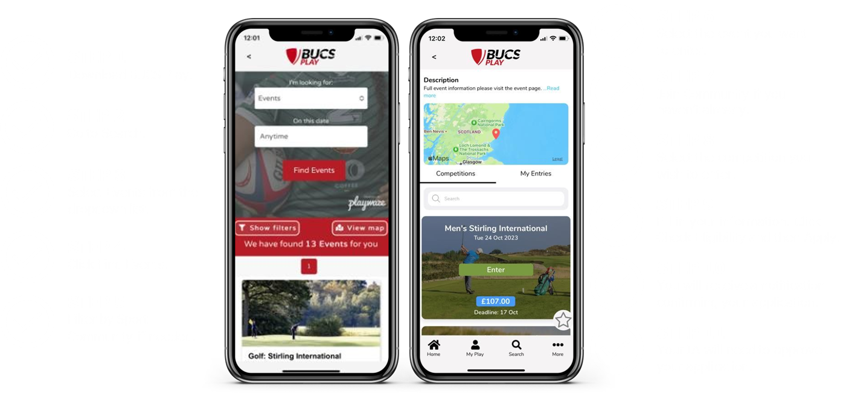
ENTERING AN INDIVIDUAL EVENT

Slide 63
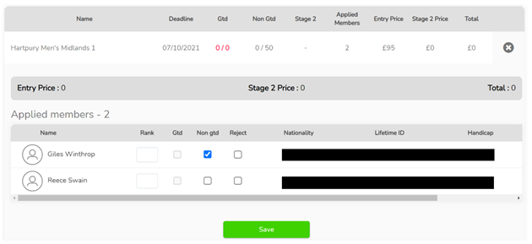
ADMINISTRATOR APPROVAL
This can only be performed by Institution Administrators (IAs) on BUCS Play. We will need to approve all your event entries via our Dashboard. Each competition has a limit to the number of guaranteed entries it will allow per institution (this will sometimes be 0). After this limit has been reached, any additional participants will need to take up non-guaranteed places, which can be ranked in priority order.
The BUCS Event Lead will determine which non-guaranteed entries are approved, based on factors such as the event’s capacity, best qualifying times, ranking etc.

Slide 64
TERMINOLOGY OF SYSTEM

Slide 65
EVENT ENTRY

Slide 66
STAGE 2 ENTRIES
If the BUCS Event Lead deems it appropriate, some events may have a Stage 2 (or late) entry window, with an increased entry fee of 20%. This gives participants a second opportunity to enter.
Stage 2 entries will not be available for every event. If the event is using a Stage 2 entry window, it will be detailed on the event page on the BUCS website.
Stage 2 entries follow the same entry process as a normal individual entry. IAs will then need to approve your entry.

Slide 67
EVENT ENTRY – ADDITIONAL INFO

Slide 68
WITHDRAWING FROM EVENTS
Participants must contact their Institution Administrator (IA) if they wish to withdraw from an event. The IA must then submit these withdrawals to the BUCS Event Lead with the necessary information.
Withdrawals that are submitted before the IA approval deadline, will not be charged. If withdrawn after the deadline and the event entry has been approved, your institution will still be billed the entry fee.
For withdrawals after the deadline and/or no shows, in certain events you will be charged a fine. This will be stated within the entry information on the relevant event page on the BUCS website.

Slide 69
summary
All participants MUST be registered on BUCS Play and in a team
Team sheets are completed on the app
Scores to be submitted by captains on the app immediately
Complete Captains packs including Playing under protest forms to be returned by 11am next working day
All fixture arrangements agreed by Essex BUCS Admin
Email bucs@essex.ac.uk for any BUCS related matters
Essex BUCS Phone contact 07935 134538

Slide 70
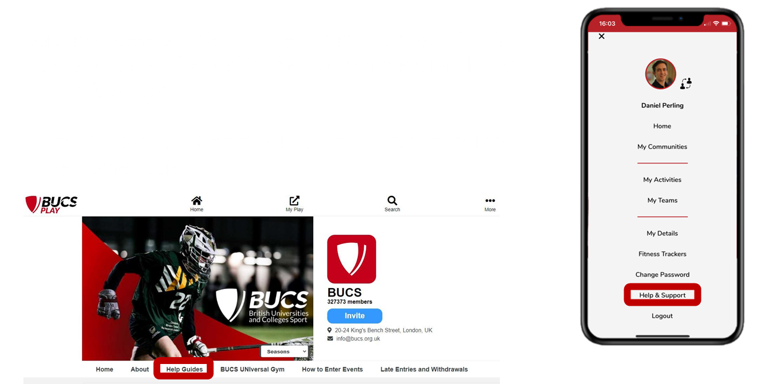
BUCS PLAY HELP AND SUPPORT

Slide 71
QUESTIONS?

